Slide 1

Landmark Recognition
Big Data Content Analytics
Eleftheria Apostolaki - Matilda Tsaka

Slide 2

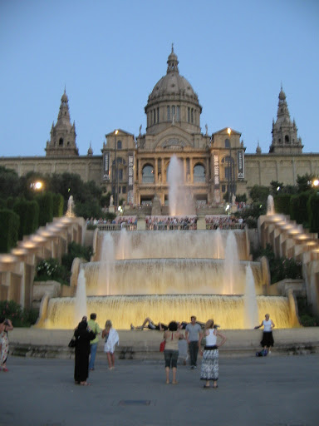
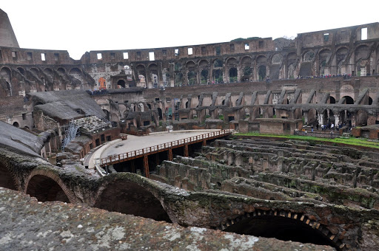
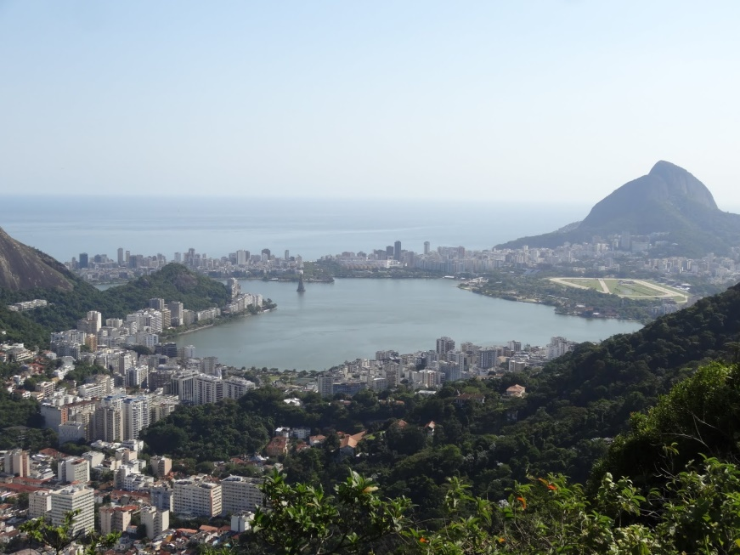
The Challenge
Predict landmark labels directly from image pixels

Slide 3
Landmark Recognition Engine
Usability
In many vision and multimedia applications
In building virtual tourism for a large number of landmarks
Obstacles
No readily available list of landmarks in the world
Efficiency is a non-trivial challenge for such a large-scale system
In tour guide recommendation and visualization
A great number of photos depicting non-landmark sights

Slide 4
Our Dataset
90.531 Training Images
22.632 Validation Images
19.951 Test Images
50 Unique Landmarks

Slide 5
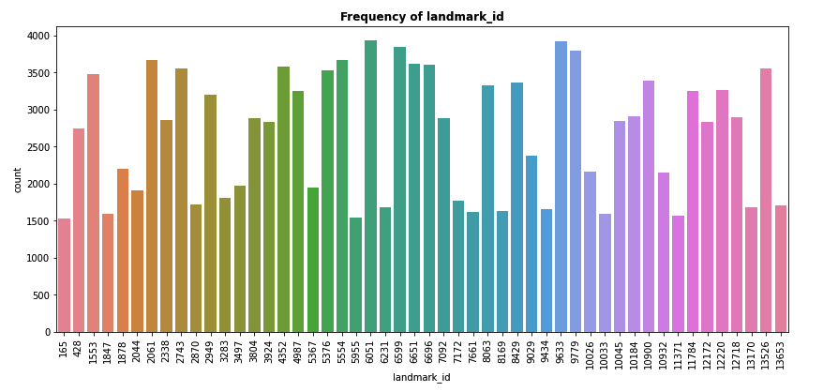
Landmark Frequency

Slide 6
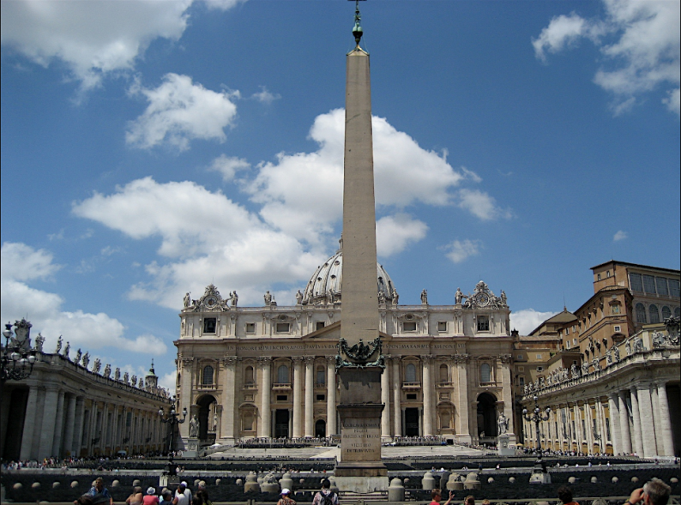
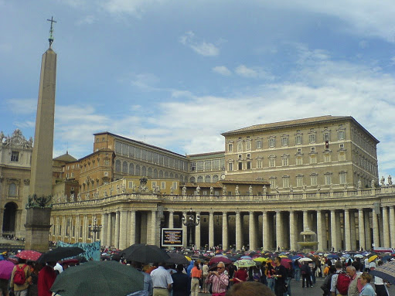
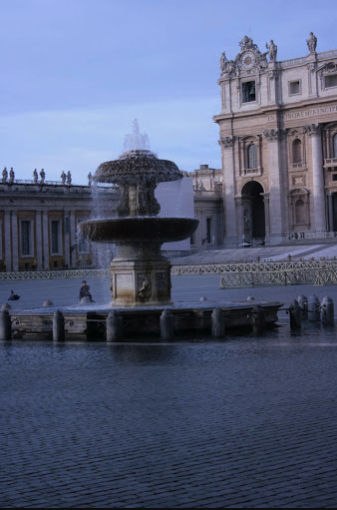
Which is the most frequent landmark?

Slide 7
Images Preprocessing
Converted images to RGB
Resized images to 150x150 pixels
Augmented images using zoom, flips, shifts and rotations

Slide 8
Building the model…
Selected CNN network as more suitable for our image classification problem.
We tried variations in number of epochs, kernel size, batch size and image augmentation to improve upon the validation accuracy.
The final model consisted of the following parts:
Input layer (Feature selection technique used to extract the images)
Hidden layers: (a) Convolutional layer (Relu technique), (b) Pooling layer (Max Pooling technique)
Output layer (Softmax classification technique)

Slide 9
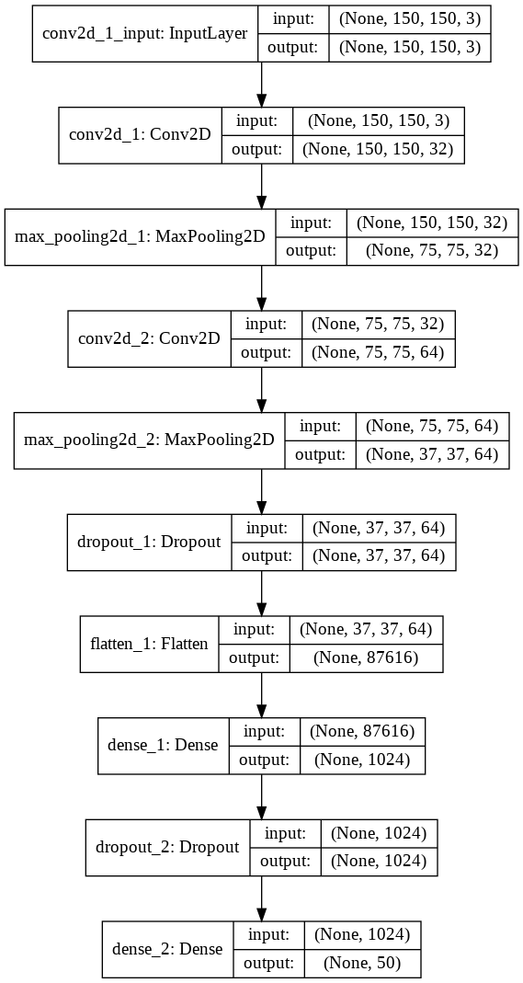
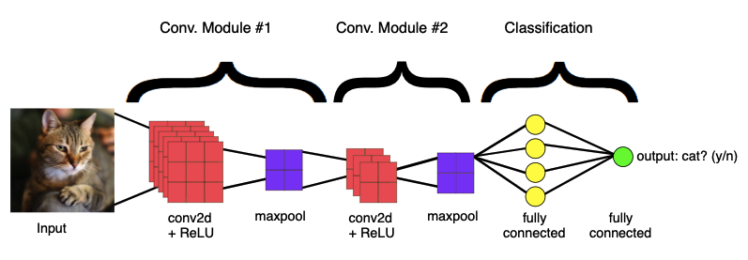
CNN Model
(Layers + Results)
Train Accuracy | 56,10%
Validation Accuracy | 66,00%
Test Accuracy | 66,17%
Time for model training | 9 hours

Slide 10
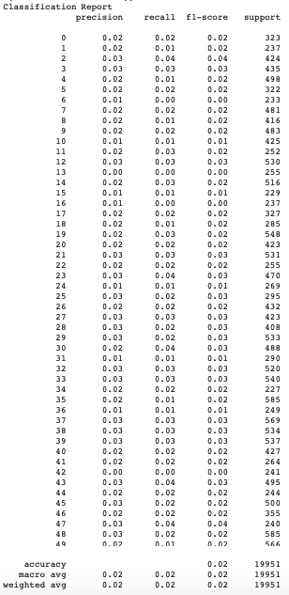
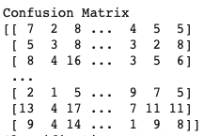
Classification Report - Confusion Matrix

Slide 11
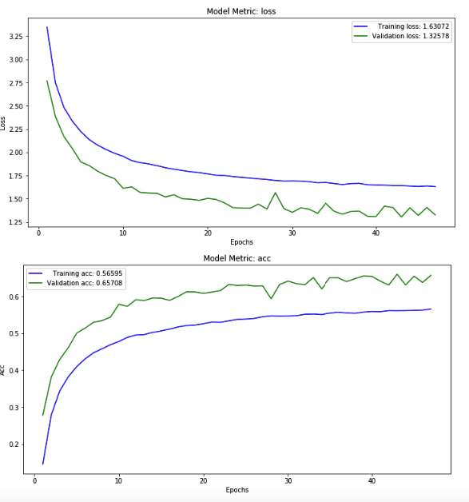
Model is in general well-trained
Model is not always learning

Slide 12
Any problems faced?
Dataset
Images with no landmark or more than one landmark in them
A small sample initially used and needed to re-upload a greater sample to train the model
Team
Delays due to insufficient available computer resources
Only 2 members with business background forcing us to have multiple roles in parallel
Not ideal time management

Slide 13


Slide 14


